Slide 1
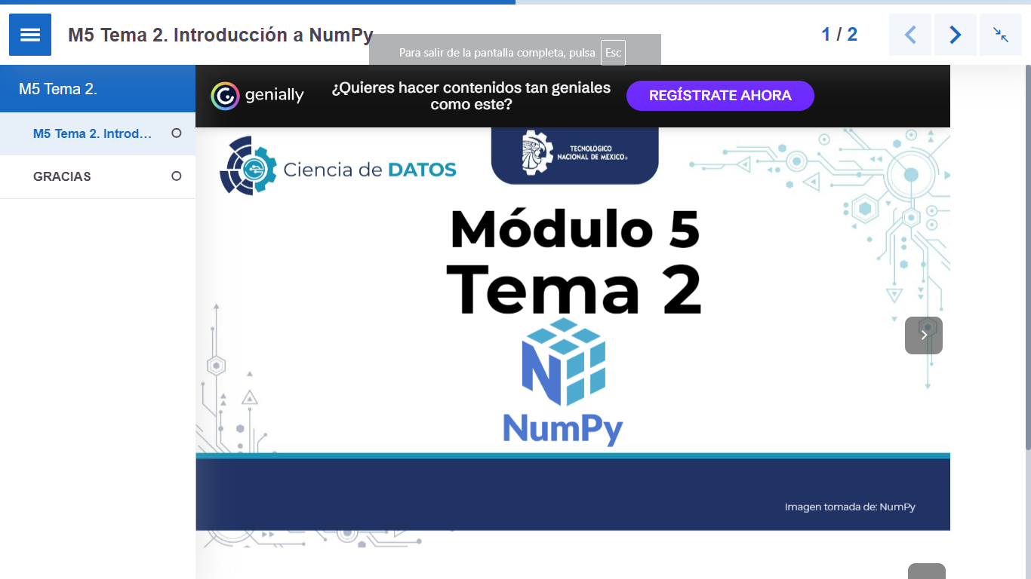

Slide 2
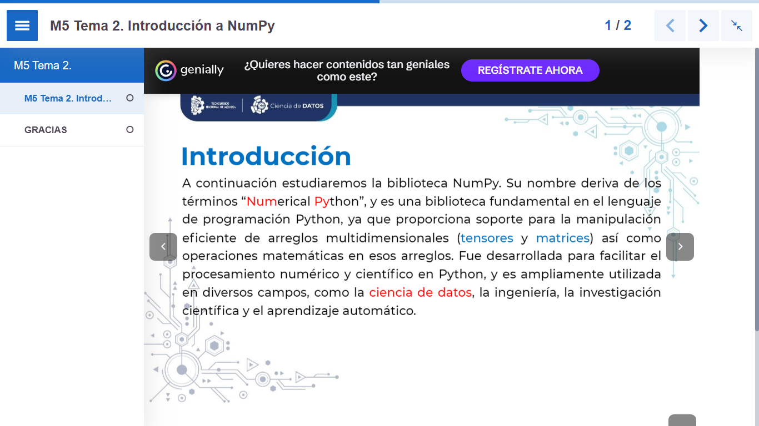

Slide 3
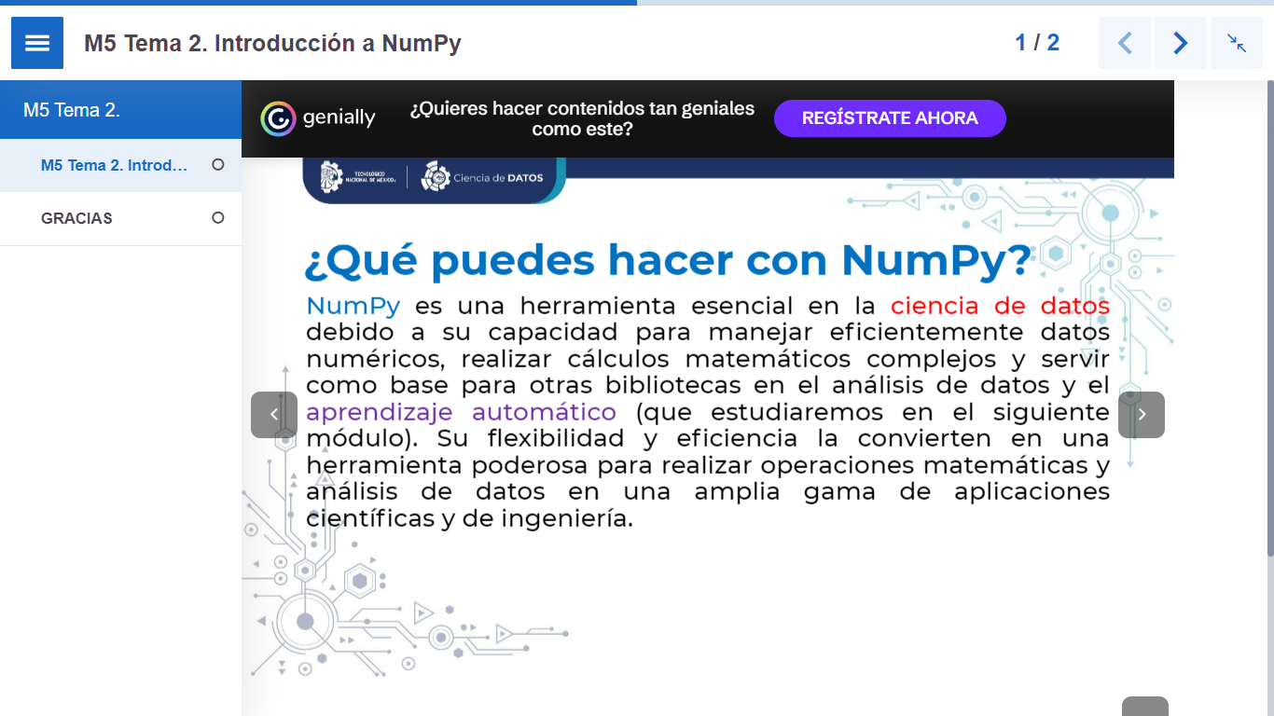

Slide 4
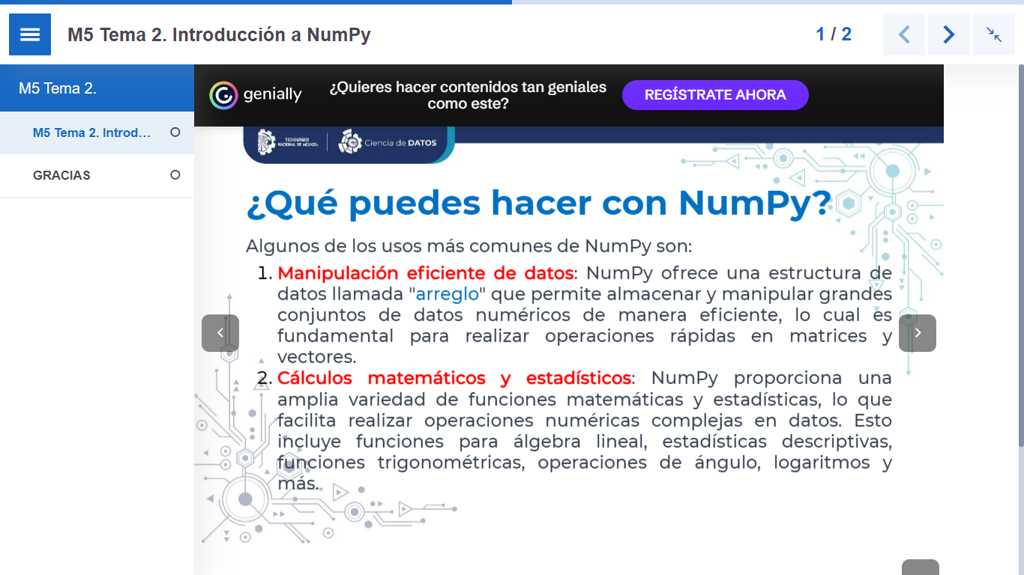

Slide 5
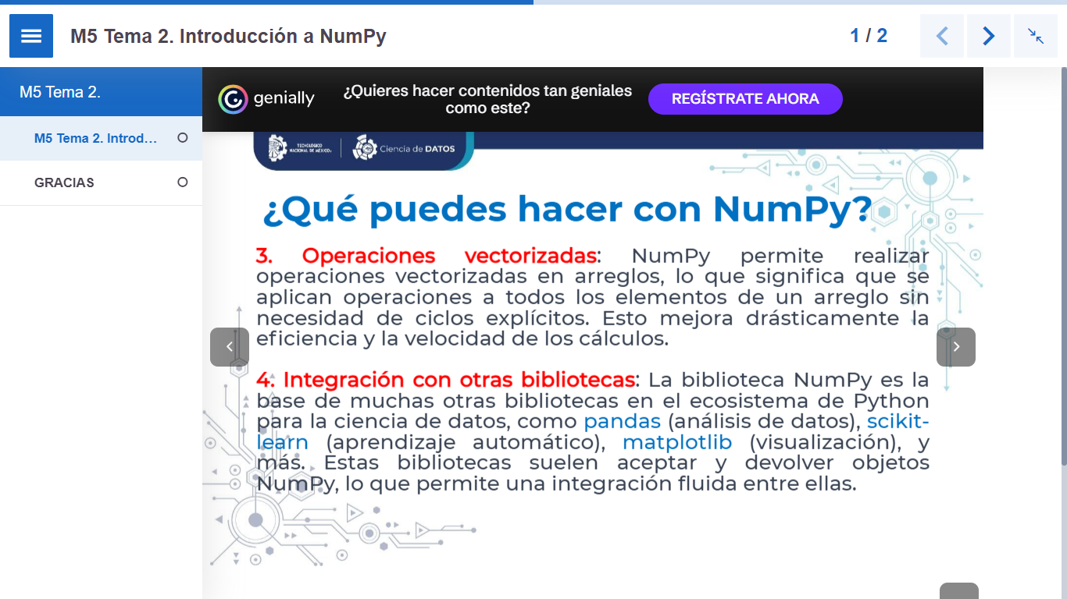

Slide 6


Slide 7
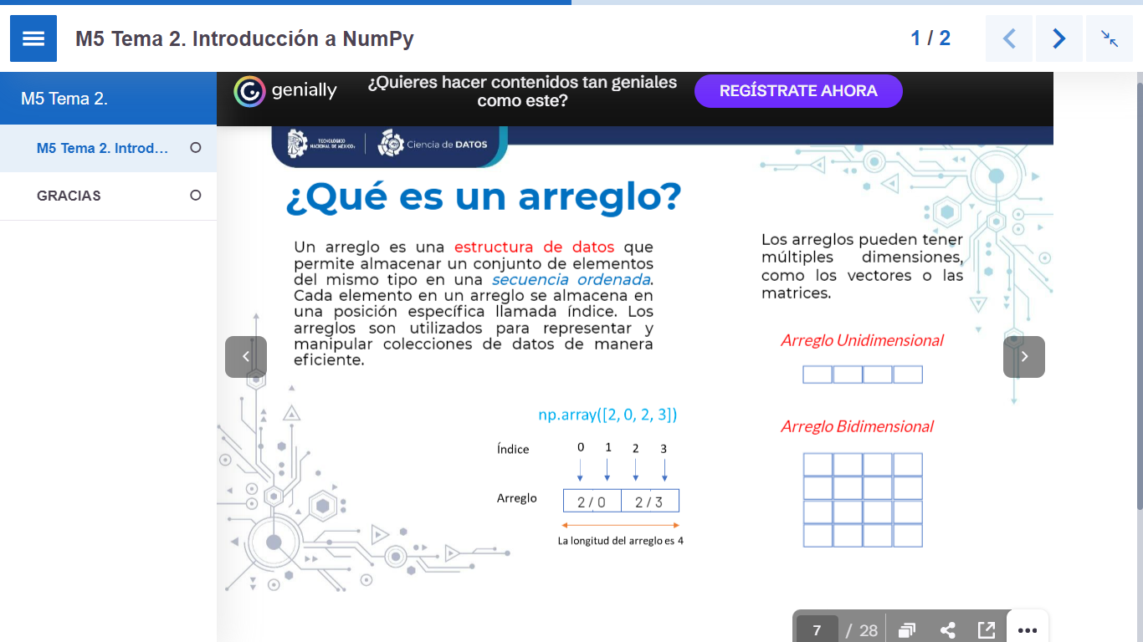

Slide 8
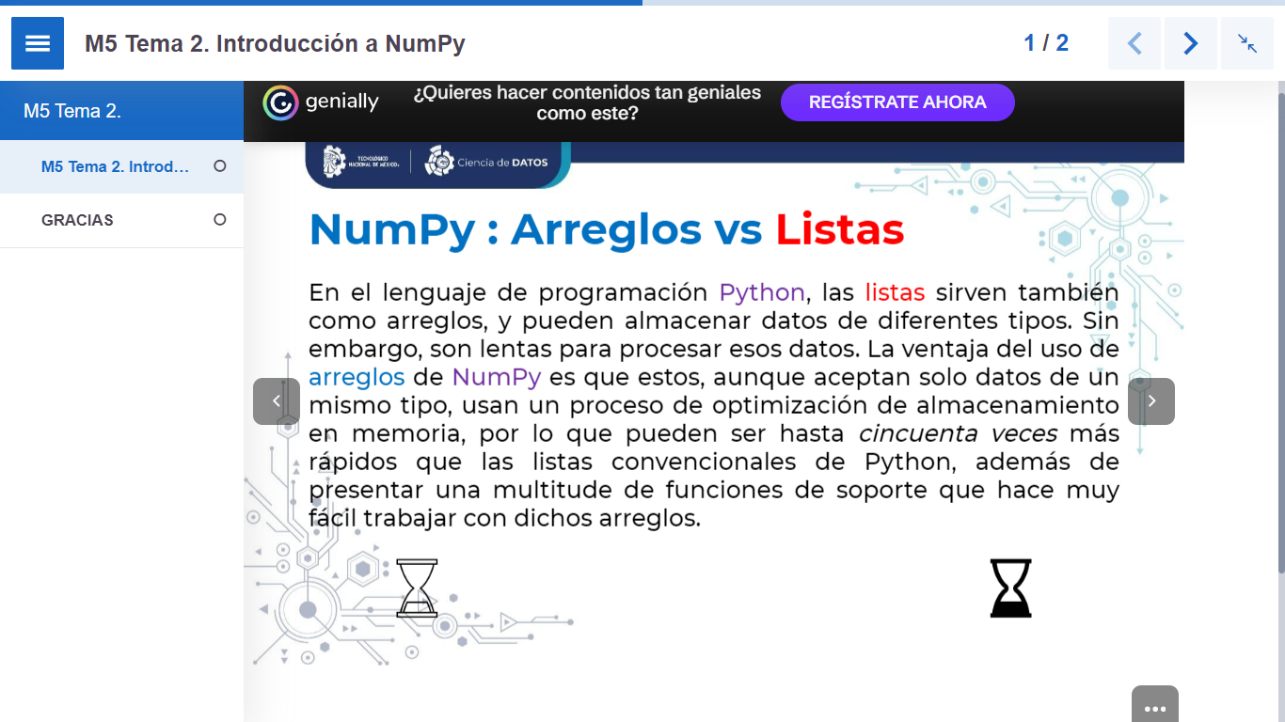

Slide 9
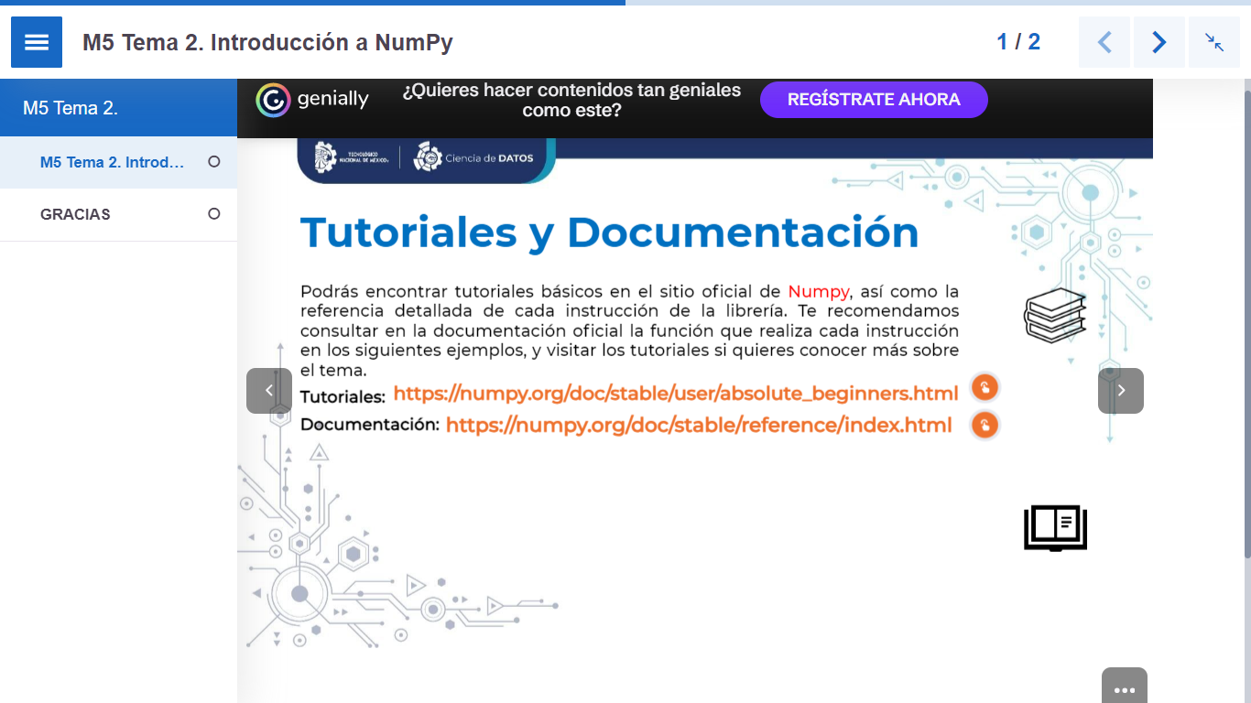
Notes:
Tuto: https://numpy.org/doc/stable/user/absolute_beginners.html
Documentacion: https://numpy.org/doc/stable/reference/index.html

Slide 10
Introduction to NumPy (w3schools.com)
https://www.w3schools.com/python/numpy/numpy_intro.asp
Python Numpy Tutorial For Beginners With Examples (devopscube.com)
https://devopscube.com/python-numpy-tutorial/
7 Numpy Practical Examples: Sample Code For Beginners (devopscube.com)
https://devopscube.com/numpy-practical-examples/#How_to_reverse_a_NumPy_array

Slide 11
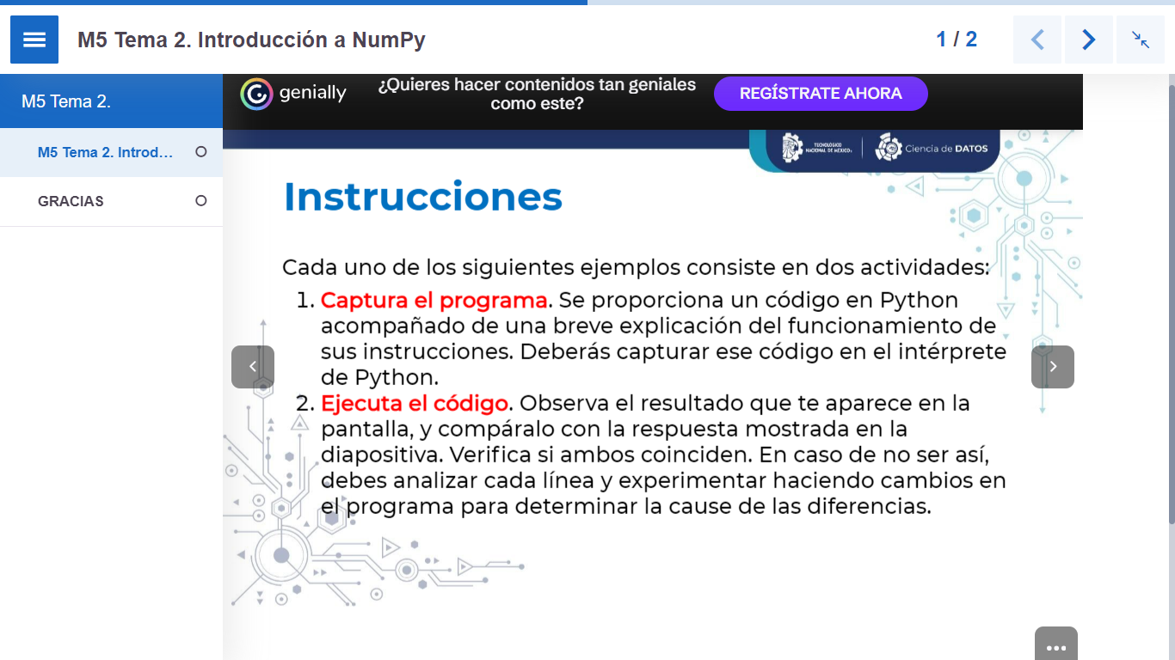

Slide 12
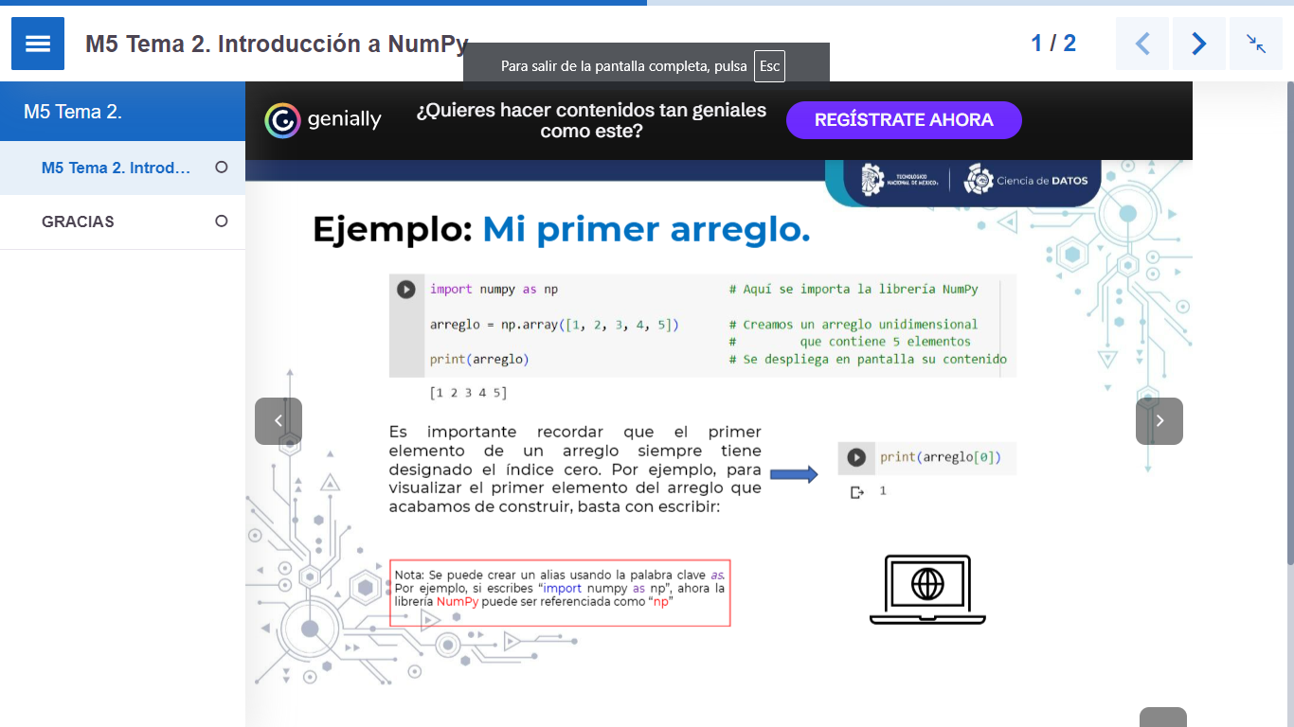

Slide 13
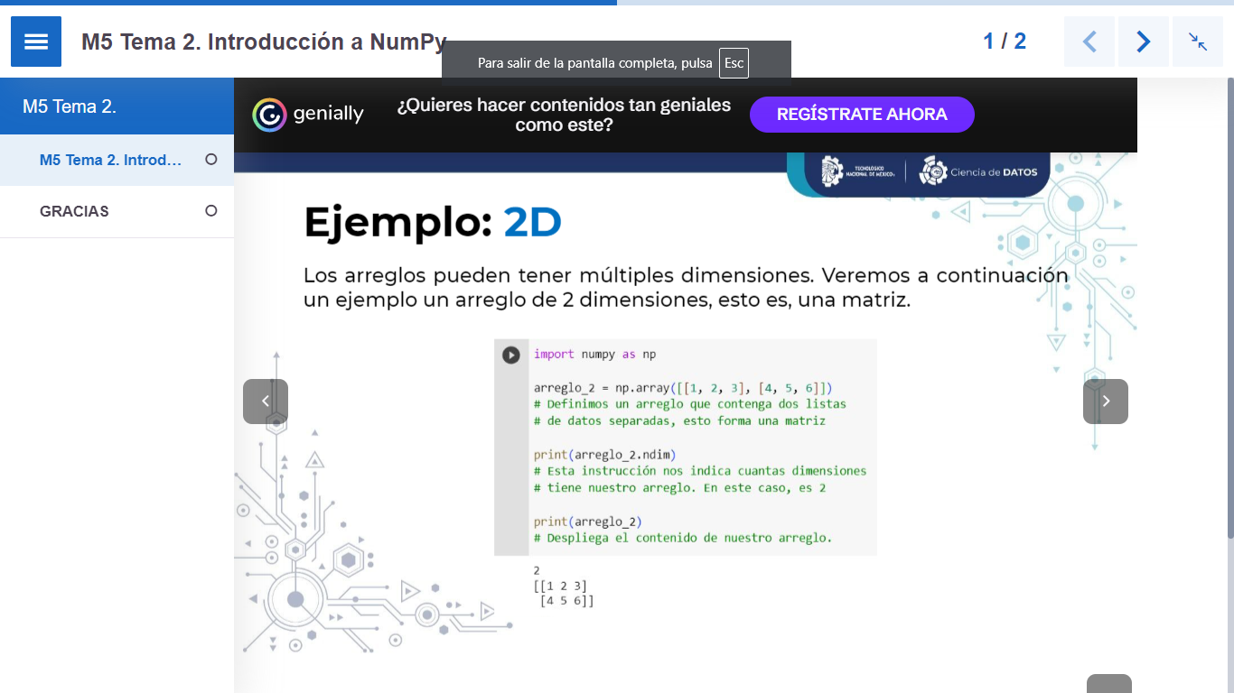

Slide 14
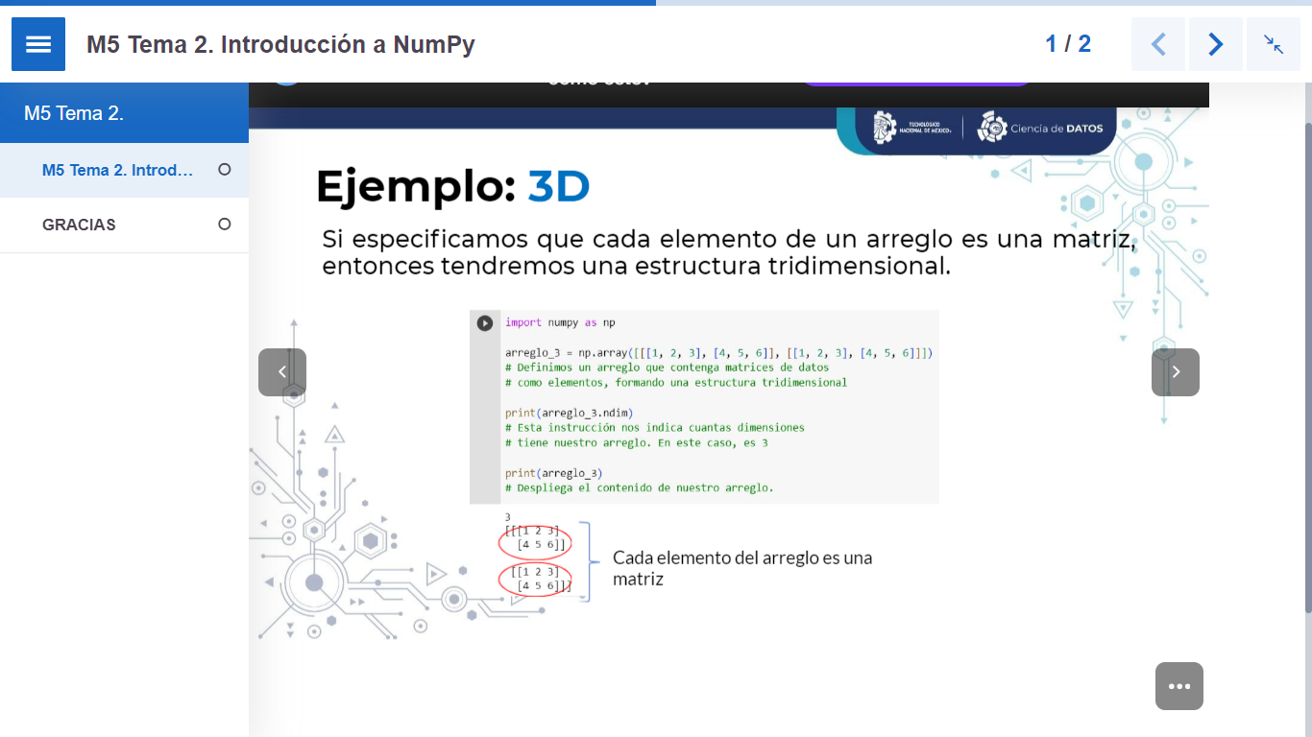

Slide 15
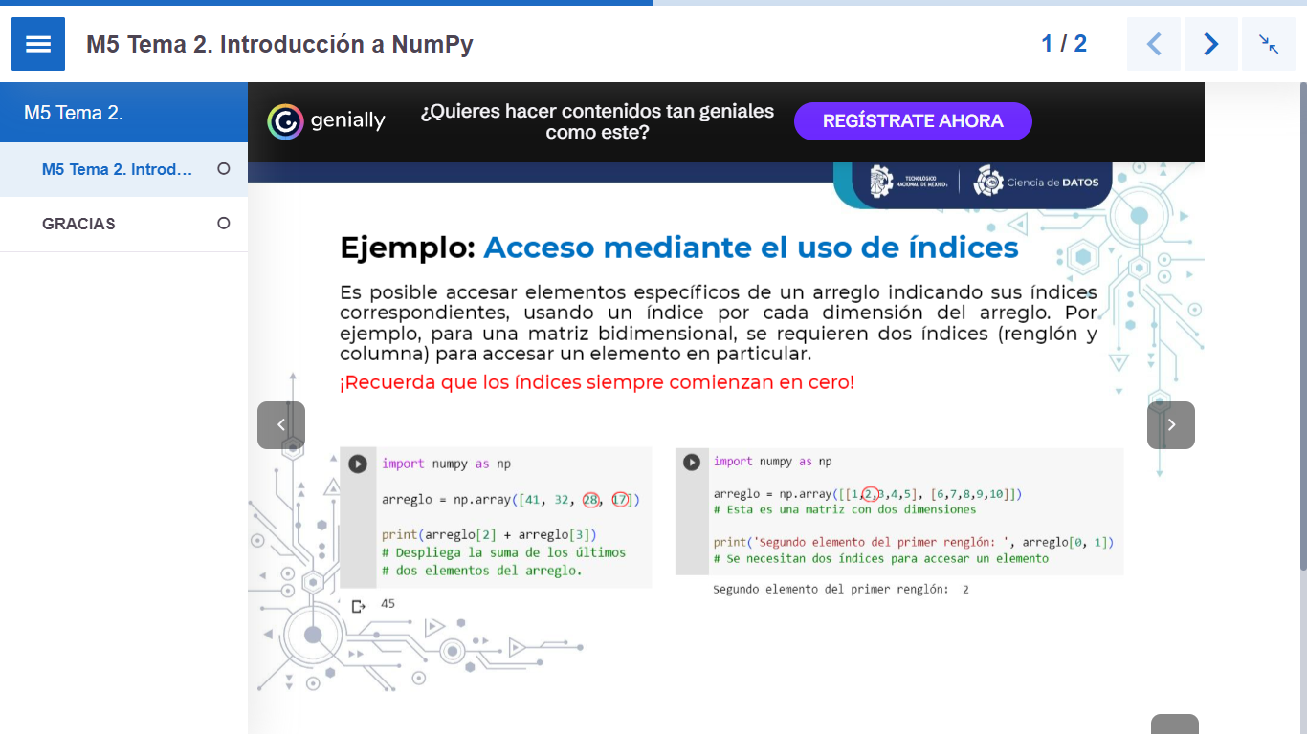

Slide 16
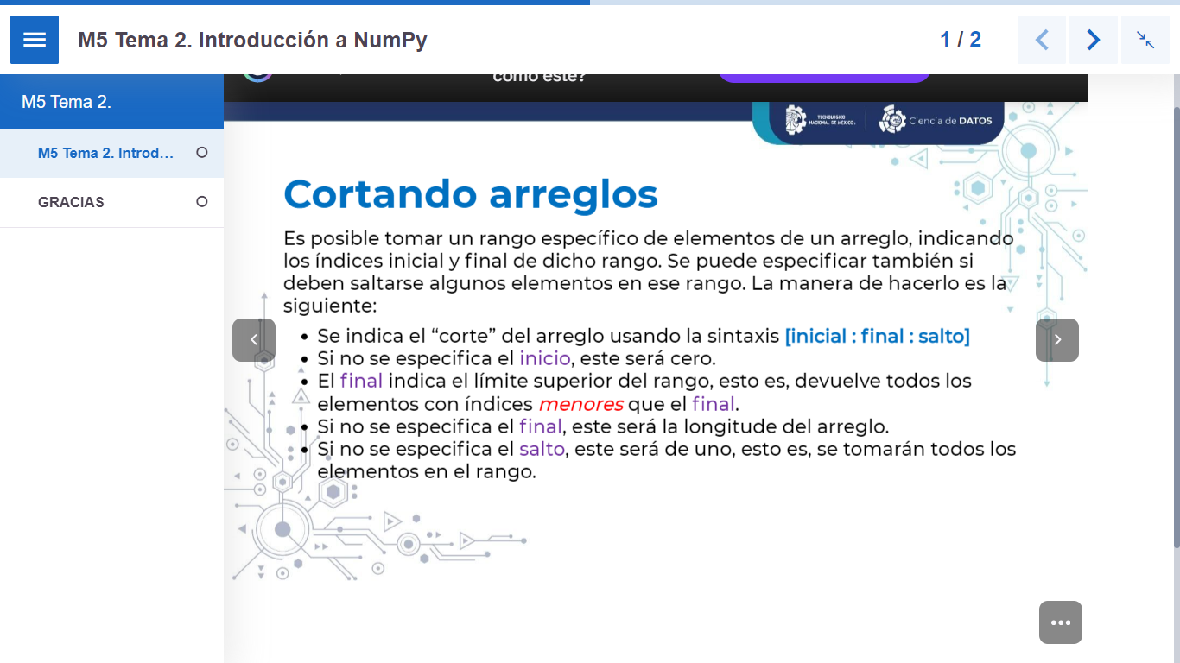

Slide 17
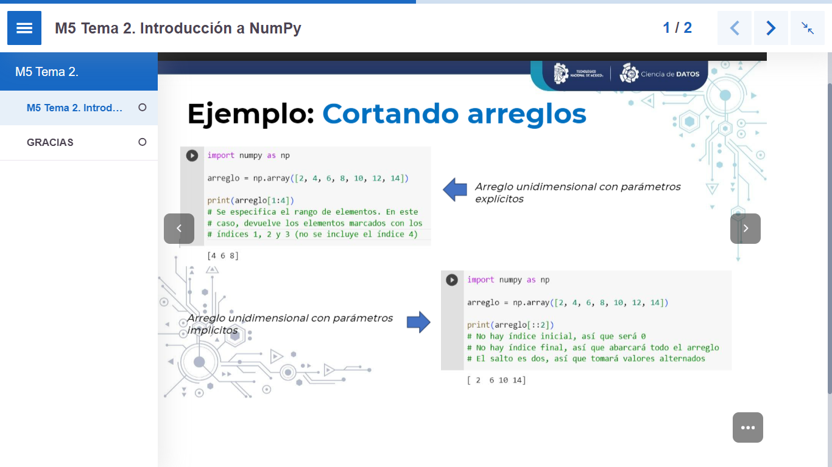

Slide 18
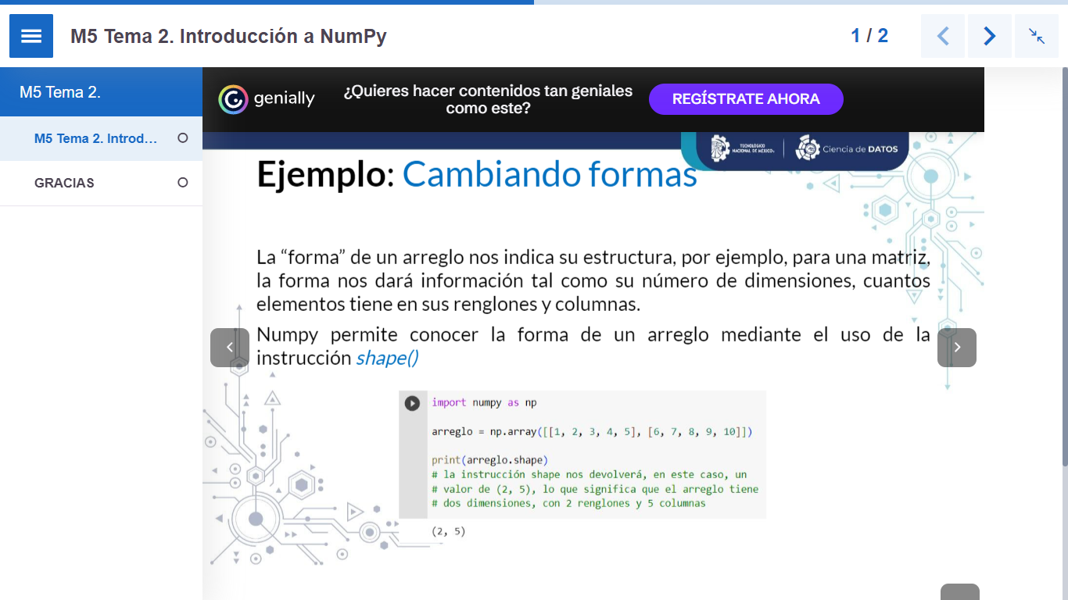

Slide 19
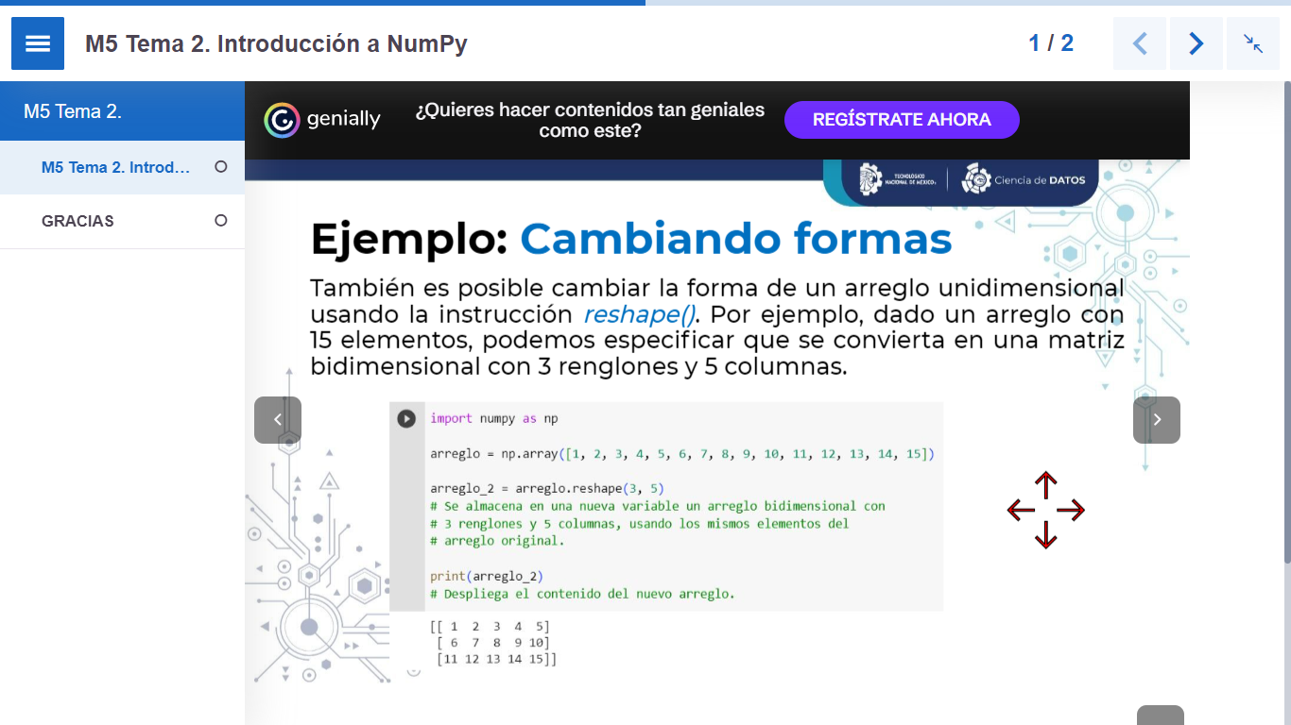

Slide 20
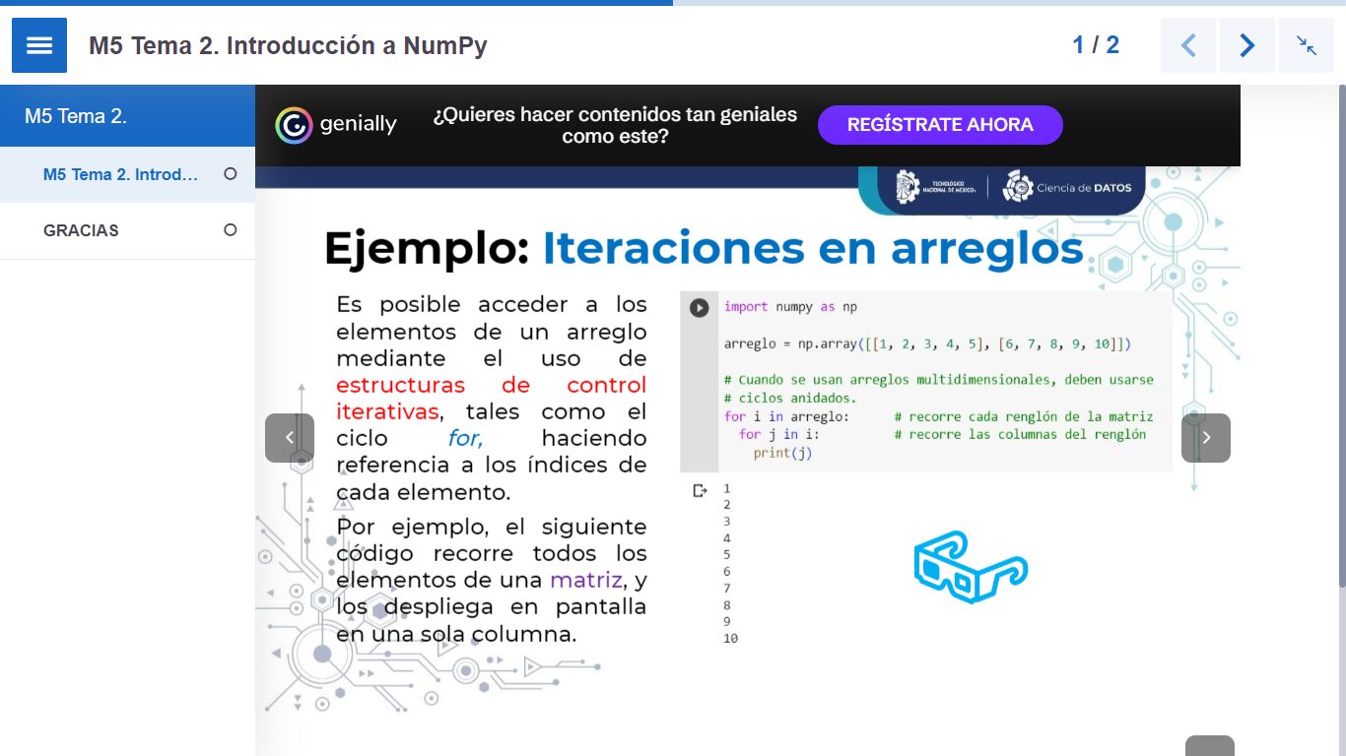

Slide 21
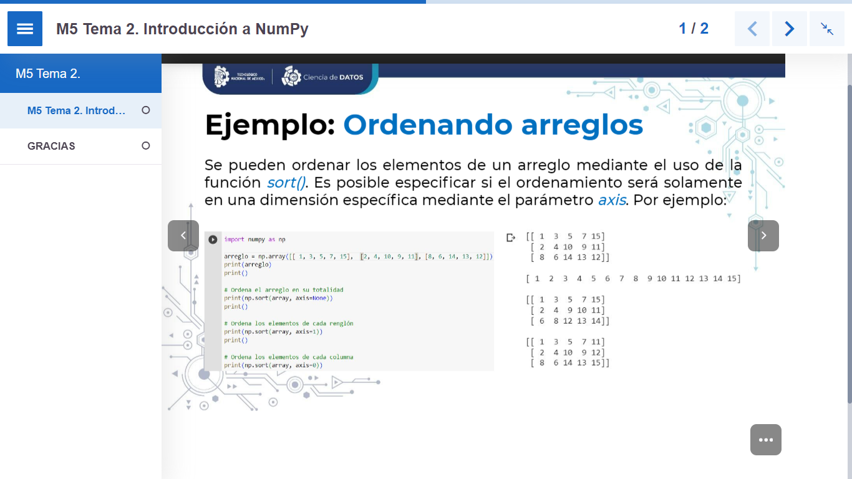

Slide 22
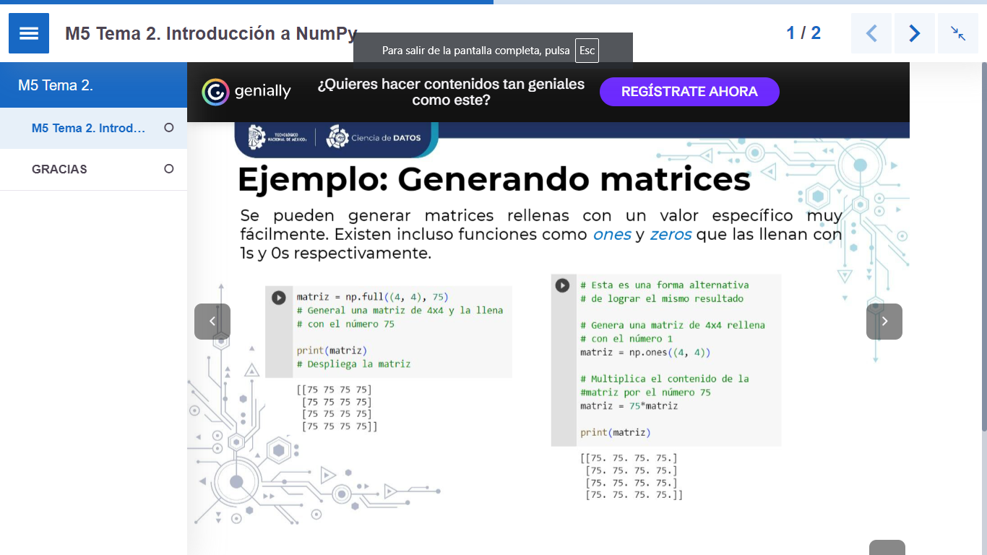

Slide 23
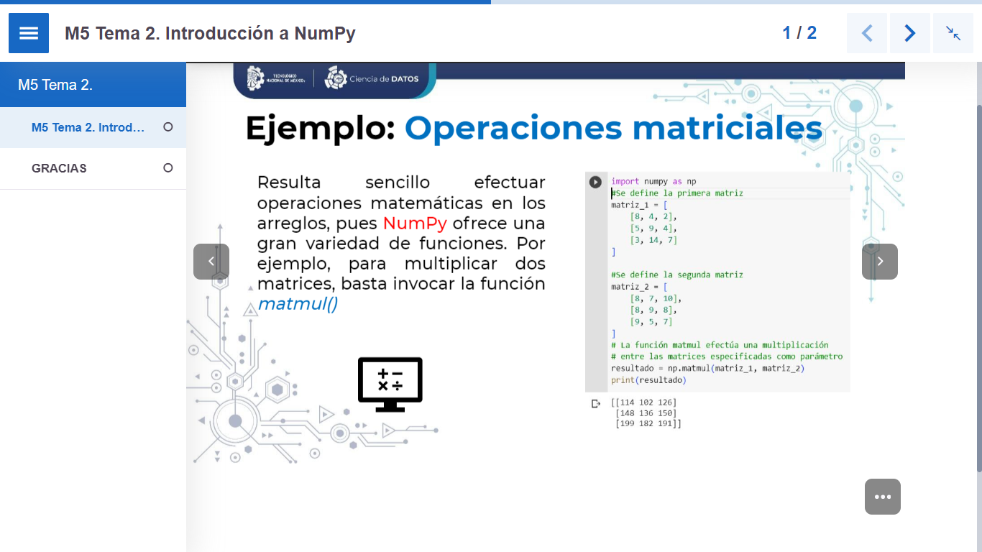

Slide 24
